Slide 1
team food insecurity
stephanie xie | angelo ragan | namita davey | medha gupta

Slide 2
what is food insecurity?
Notes:
Plant someone

Slide 3
food insecurity (n.)
the state of being without reliable access to a sufficient quantity of affordable, nutritious food.
Notes:
What does this look like at Rice (definition on google)
According to WHO: Available (food is produced or sold within a reasonable distance)
Available (food is produced or sold within a reasonable distance)
Accessible (food is affordable and physically present)
Stable (food access is not affected by seasonal disturbances or warfare)
Usable (food is safe and will not cause harm to the consumer)
Mild: worrying about ability to obtain food
Moderate: compromising quality and variety of food
Severe: experiencing hunger

Slide 4
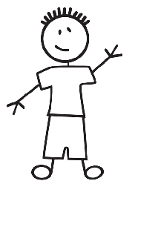
Meet Bob.
Bob is a junior off-campus student with a reduced meal plan. He just finished a meeting and is hungry, but...
Lacks time to cook and buy groceries
Sammy’s and Brochstein are too expensive
Feels uncomfortable asking for a guest swipe
So, he snacks on junk food for dinner.
Notes:
Existing solution: Include photo of food pantry
SA and SSI
Compass
Food pantry run by SSI
Sa interest in improving it
Funding by corporation Compass, interest in food pantry

Slide 5
42.6% of students miss 1-3 meals a week
26.7% of students miss 4-7 meals a week
49.5% miss meals because they don’t have time
0out of101 have used the food pantry

Slide 6
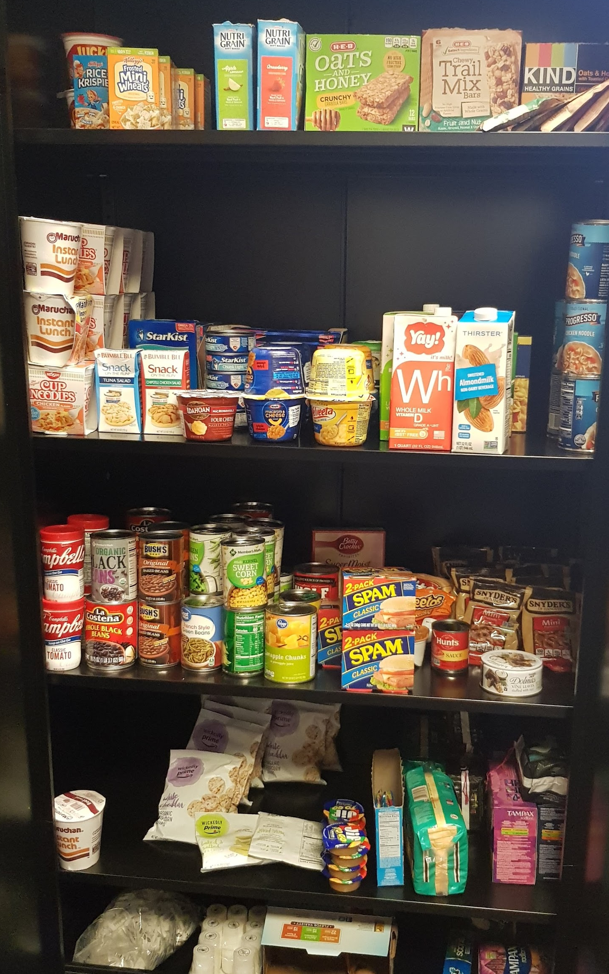
Existing Solution & Community Partners
Notes:
Existing solution: Include photo of food pantry
SA and SSI
Compass
Food pantry run by SSI
Sa interest in improving it
Funding by corporation Compass, interest in food pantry

Slide 7
HCW encourage Rice off-campus students to use the food pantry by increasing awareness about the food pantry and food insecurity?
Notes:
-

Slide 8
Key Insights
Students believe that...
Food insecurity = not having the money to buy food
The food pantry is only for low-income students
We found that...
“Food pantry” is associated with stigma
Word of mouth from friends is more compelling than administrative announcements
Notes:
So first we decided to do some research.
We each conducted in person interviews with 2-3 off campus students,
We sent out a survey that received over 100 responses
And talked to contacts at the SSI and SA.
Mention user insigghts, ie) not knowing if food pantry resource is for them

Slide 9
What does a successful solution look like?
Make users feel comfortable using the food pantry and included in the user base
Increase the visibility of the location and hours of the food pantry
Increase awareness of the different causes of food insecurity through a non-stigmatizing avenue
Self-sustaining
Notes:
What is the intended impact of each of these goals?

Slide 10
Initial Feasible Solution
Advertising & Rebranding:
Reduce perceived stigma with use
Self-sustaining posters to advertise the pantry as a resource for everyone
Rebrand food pantry
Student Involvement:
Involving college OC Representatives to promote the food pantry as a resource
Notes:
Posters are easier to use to promote anonymity versus a social media based campaign where students can be isolated
Rebranding the food pantry
Current name and posters approach the issue from a more serious angle that we have found to alienate some students because it’s very “hush hush”
We believe that when hearing about a resource from fellow students vs. official SSI webpages the students are more likely to check out the resource as this is how we have found that most current students hear about the food pantry

Slide 11
Testing
We will...
Present poster mockups with food pantry information, and test users before and after encountering the solution
Testing for improvement on...
Who can and should use the food pantry
Navigatibility to the food pantry
Awareness of open hours
Notes:
Presenting with poster and asking user to easily navigate to pantry
Survey during test rounds of different food pantry names

Slide 12
Next steps
Build a low fidelity prototype of our posters
Testing a variety of names for pantry rebranding
Learning how people hear about resources on campus
Creating a sustainable student led campaign
Discussing feasibility and implementation with SSI

Slide 13
Questions for audience
What prompts you to check out resources on campus?
What are any ways that you can think of to talk about food insecurity casually?

Slide 14
thank you!!

